Slide 1

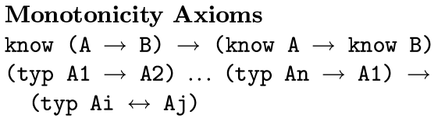
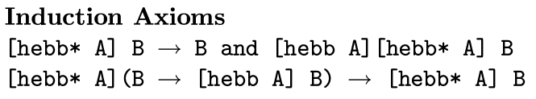
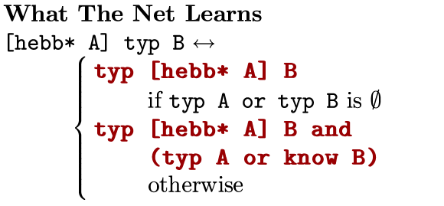
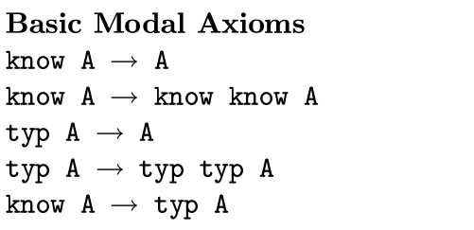
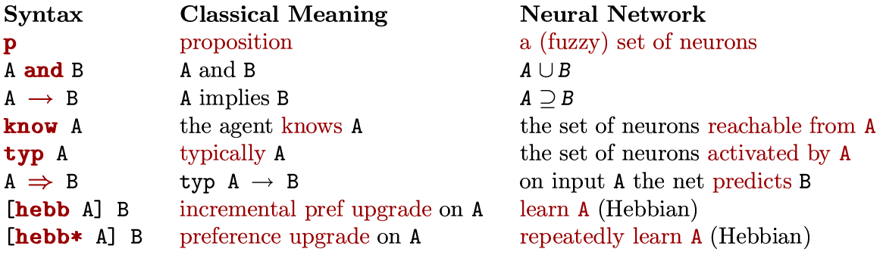
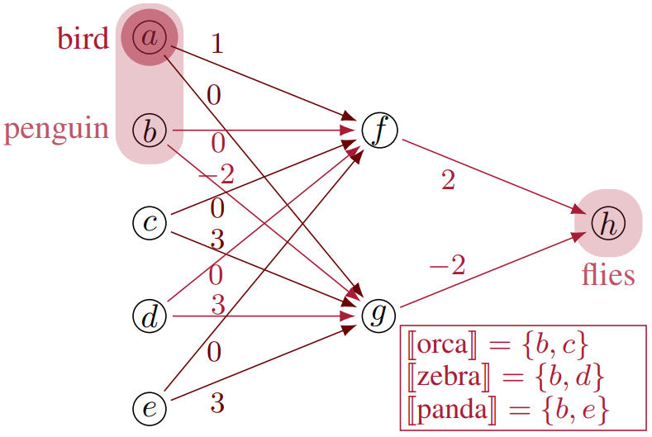

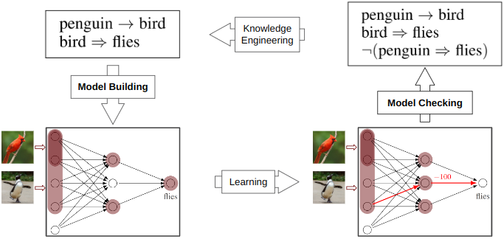


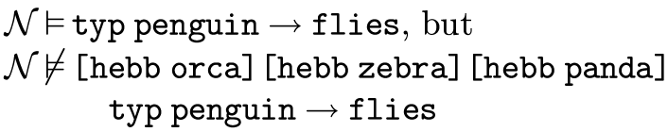
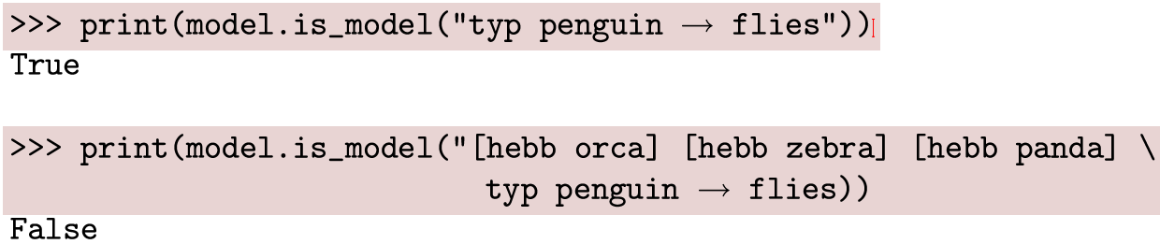

Reasoning about Neural Network Learning
Caleb Kisby, Saúl Blanco, and Lawrence Moss
Luddy School of Informatics, Computing, and Engineering
Reasoning about Static Nets
Reasoning about Learning
Model Checking
Model Building
Task: Does the net satisfy P?
Task: Build a net that satisfies P.
Work in Progress
Use Lean to verify model checking code
Finish proof for model building
Extend system to reason about fuzzy sets
Extend with (backpropagation)
github.com/ais-climber/neural-semantics
Acknowledgments: This work was funded by the US Department of Defense (Contract W52P1J2093009). Thank you for your support!

